Slide 1
JavaScript Test Coverage a warm blanket on a rainy day
April 26, 2019
Notes:
Ask questions about the audiences experience with testing as an ice breaker.

Slide 2
Aaron Stanley King
@trendoid on Twitter, LinkedIn, etc.
trendoid@gmail.com
Solutions Architect at Barefoot Proximity I work with a team to design world class web experiences for global brands. My role as a full-stack developer is to help architect the technical aspects of the projects and bring them to life.
Notes:
Talk also about previous roles to bring context to the situation. Don’t bad mouth employers.
Currently – start of new greenfield development and role of Solutions Architect
Previous – Some developers used TDD
Before that – little to know test coverage on client side some
Before that – testing consultant using TFS and Microsoft Test Manager
Before that – Classic ASP, PHP, and Perl

Slide 3
Agenda trying to stay hidden under the blanket
What is test coverage?
Where do we need coverage?
Who benefits from test coverage?
Why do I care so much about coverage?
Notes:
Don’t ya love rainy days sitting with a hot cup of coffee, just coding on a great new feature instead of bugs.

Slide 4
What is test coverage?
Notes:
I always start off with two definitions.

Slide 5

What is test coverage?
Definition
Test coverage is a measure used to describe the degree to which the source code of a program is executed when a particular test suite runs. A program with high test coverage, measured as a percentage, has had more of its source code executed during testing, which suggests it has a lower chance of containing undetected software bugs compared to a program with low test coverage. - Wikipedia
Notes:
Seem legit. Sounds very boring and I don’t think that will keep me off the conference calls about bugs.

Slide 6
Test coverage is a useful tool for finding untested parts of a codebase. Test coverage is of little use as a numeric statement of how good your tests are.
Martin Fowler
Notes:
Martin Fowler (born 1963) is a British software developer, author and international public speaker on software development, specialising in object-oriented analysis and design, UML, patterns, and agile software development methodologies, including extreme programming.
His 1999 book Refactoring popularised the practice of code refactoring.^{[2]} In 2004 he introduced Presentation Model (PM), an architectural pattern.^{[3]}

Slide 7
Where do we need coverage?
(and how much to we need)

Slide 8
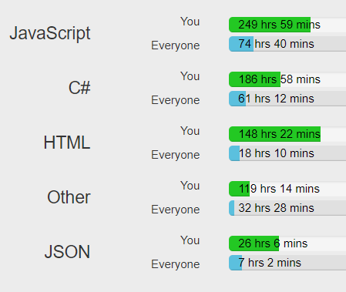
Where do we need coverage?
Numbers
In 2018, WakaTime users programmed for a combined 20,341,186 hrs 56 mins!
The top languages were JavaScript (4,046,216 hrs), PHP (2,438,564 hrs), Java (1,647,111 hrs), TypeScript (1,112,509 hrs), Python (1,020,992 hrs), and HTML (998,286 hrs). We could probably count TypeScript together with JavaScript for a combined 5,158,725 hrs, over twice as much as the runner up language PHP. JavaScript really is eating the world!
https://wakatime.com/a-look-back-at-2018
Notes:
Which languages need more coverage? If we go to Martin Fowler: Test coverage is a useful tool for finding untested parts of a codebase. Test coverage is of little use as a numeric statement of how good your tests are.

Slide 9
Code
Notes:
Follow the readme from https://github.com/trendoid/JavaScriptTestCoverage/blob/master/README.md
Reason I picked this is because of work. The next project is greenfield and starts with React.

Slide 10

Review
Code
Created a new application
Added libraries
Registered scripts
Deployed to Git
Setup Travis CI
Setup CoverAlls.io
Added badges to our README

Slide 11
Who benefits from test coverage? (even if they don’t care)
Notes:
Its not just about the developers. Even though my focus will always probably be the team I’m on. The organization as a whole needs to benefit for us to all be happy or we’ll get fallout when quality is bad.

Slide 12



Owner
Tester
Developer
Notes:
Product owners get the reports and working code.
Testers get the reports and working code to test. Perhaps it even saves them some time in regression.
Developers can see the exposure their changes might have. They get to point to the reports. They get to sleep at night knowing they did a good job in the full stack.

Slide 13
Why do I care so much about this test coverage crap anyway?

Slide 14
Why do I care so much about test coverage?
Family
Stress (I’m lazy)
Larger Teams
Larger deployments
International, less timely deployments
Micro Services
Load balancing only means it breaks twice
I think that computers and technology help me lead a more fulfilling life and make best use of my time.
Notes:
Family – downtime or production issues are never 8-5
Stress – not fun working on code that is brittle
Larger teams – not fun working on large teams when others break your stuff or merge over you
Larger deployments – you can’t see all the code at once and you might be deploying code you didn’t even review
International, less timely deployments – there is not midnight on a Friday
Micro Services – everything is calling everything else
Load balancing only works for uptime not correctness – when you deploy, it gets broke in both servers after the second one is turned on. Unless you are lucky enough to have good tests and testers who can find everything when you’re on one node or the other.

Slide 15
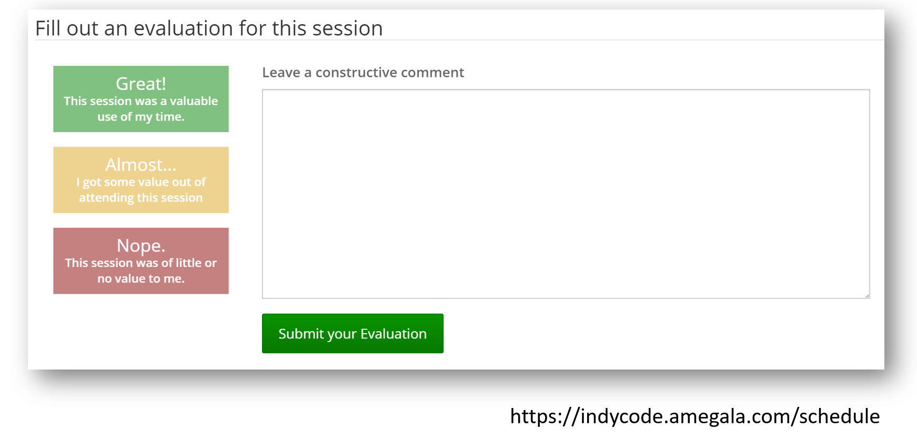
Evaluations

Slide 16
Thank you.
Notes:
Don’t forget to answer questions!

Slide 17
Aaron Stanley King
@trendoid on Twitter, LinkedIn, etc.
trendoid@gmail.com
Solutions Architect at Barefoot Proximity https://github.com/trendoid/JavaScriptTestCoverage

